Slide 1
Structured Data Capture (SDC) and Questionnaire
Lloyd McKenzie
November 16, 2016

Slide 2

Who am I?
Name: Lloyd McKenzie
Company: Gevity
Background:
One of FHIR’s 3 initial editors
Co-chair MnM, FMG & FHIR Infrastructure
Technical lead for ONC’s FHIR SDC project
Heavily involved in HL7 and healthcare exchange for last 16 years (v2, v3, CDA, etc.)
lmckenzie@gevityinc.com

Slide 3
Objectives
Explain intended use of Questionnaire / QuestionnaireResponse
Identify some “advanced” Questionnaire capabilities
Describe the scope of the U.S. Structured Data Capture IG
Discuss IG’s applicability outside the U.S. context

Slide 4
Questionnaire
Q: What can Questionnaire be used to capture?
A: ANYTHING

Slide 5
Purpose of Questionnaire
Direct data capture (and presentation) for humans
Controls
how the questions are phrased
order (and conditionality) of asking
constraints on allowed responses
E.g. min/max values
List of allowed values
Patterns/regular expressions

Slide 6
What Questionnaire can’t do
Questionnaire does not support:
Consistent representation of data
The same information could be gathered by numerous questionnaire with different questions
Querying based on answer values
Questions can be at varying depths – expressing the tuples RESTfully is too hard
Direct aggregation/combination of data from different sources
Unless captured using identical questionnaire

Slide 7
Therefore, typically
Raw data is captured using Questionnaires
If there’s a need for tight control over data capture
If client system won’t have a tuned user-interface
Responses are typically converted to other resources
Supports aggregation/query/analysis
Linkage from Raw data to produced resources by Provenance

Slide 8
Sometimes
Process can be reversed
Auto-populate QuestionnaireResponse instances from existing data
Display QuestionnaireResponses with questions defined in Questionnaire
Allows presentation using a standard user interface
No real benefit over just generating an HTML narrative unless you want the user to be able to adjust data

Slide 9
Structure of a Questionnaire
Questionnaire
Metadata
Item
(Group,
Question or
Display

Slide 10
Types of Item
Groups
Organize content of questionnaire
Must have children
Can’t have answers
Questions
Solicit information
Must have answers (but can be optional)
Display
Additional text, no children, no answers

Slide 11
Anatomy of a Question
5.a) What pizza toppings would you like? (choose at least 1)
Cheese
Ham
Mushrooms
Other
(please specify): ____________
Label
Text
Child “text” item (implies required = true, repeats = true)
option or options
Nested “question” item (enableWhen tied to “Other” answer)
Notes:
Options allows you to point to a value set, option allows enumerating individual potential elements

Slide 12
Advanced Questionnaire capabilities
enableWhen
minOccurs, maxOccurs
translations
itemControl, usageMode
allowedResource, allowedProfile
lookupQuestionnaire, referenceFilter
minLength, maxLength, maxSize, minValue, maxValue, mimeType, etc.
Notes:
itemControl – fly-over, Table, Checkbox
usageMode – capture, display, display-non-empty

Slide 13
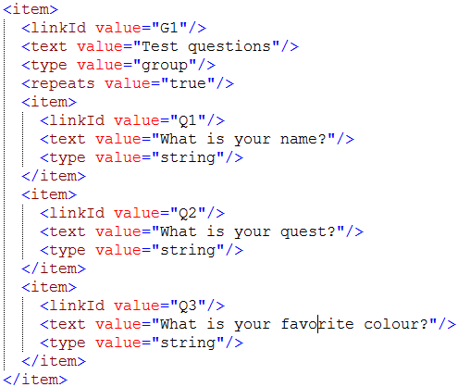
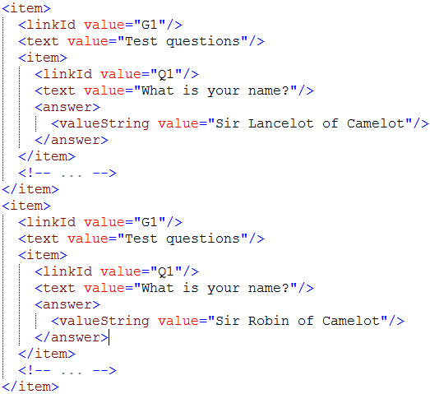
Linking Questionnaire to QuestionnaireResponse
Questionnaire
QuestionnaireResponse

Slide 14
Structured Data Capture (SDC)
U.S. Office of the National Coordinator for Healthcare (ONC) initiated project
Parallel efforts in IHE (custom schema) and FHIR
FHIR effort has 2 focuses
Supporting standardization of Questionnaire usage and enabling pre-population and auto-population
Standardizing the sharing of data elements

Slide 15
Pre-pop and Auto-pop
Pre-population
An EHR or other data entry system solicits a 3rd party to fill in questionnaire with information submitted to that third party and/or information the third party already holds
Auto-population
An EHR or other data entry system fills in questionnaire with information it holds itself

Slide 16
Use cases
Submitting forms for clinical research
Submitting public health forms
Submitting and processing electronic insurance claims
Save time
Reduce transcription error
Ensure consistency of data

Slide 17
Pre-population operations
$populate
Get back a QuestionnaireResponse
$populatehtml
Get back HTML with active submit button
$populatelink
Get back URL to site displaying interactive (and partially populated) form

Slide 18
Enabling Questionnaire population
Extension linking to data element with mapping
ConceptMap linking Questionnaire questions to data elements with mappings
Concept map linking Questionnaire questions to source data

Slide 19
What makes SDC U.S.-specific?
The SDC-DE (Data Element Maintenance) IG includes U.S.-specific vocabulary bindings
The main SDC IG is generic however
Fully appropriate to use outside the U.S.

Slide 20


Questions / Discussion?
http://hl7.org/fhir lmckenzie@gevityinc.com
http://hl7.org/fhir/us/sdc

